Slide 1
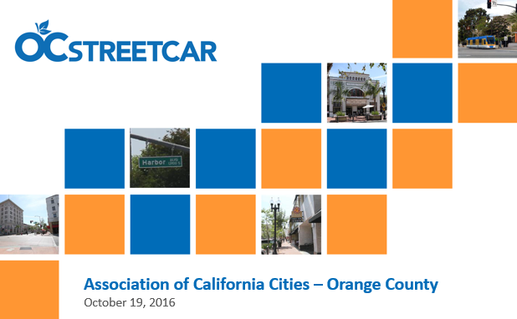



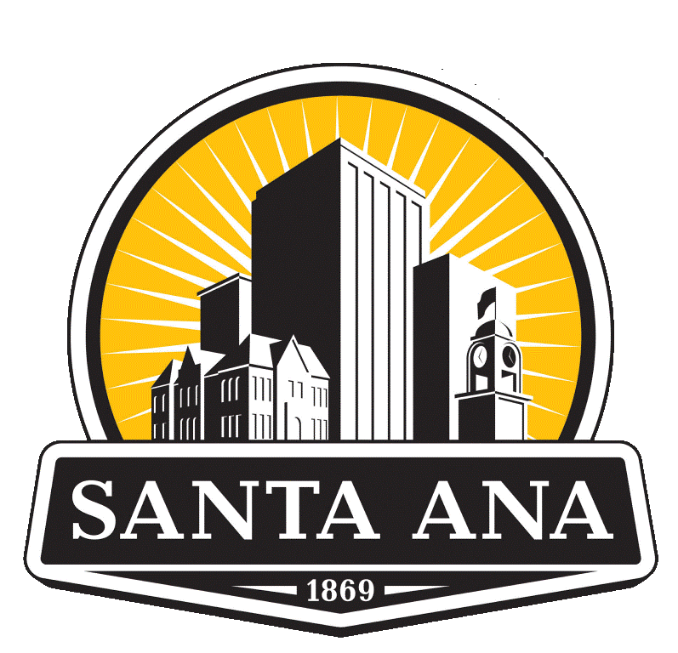

OC Streetcar Project Update
Community Advisory Committee – January 2019

Slide 2

OC Streetcar Background
Funding:
Project S Transit Extensions connects Metrolink
(rail service) to activity Centers and communities
formerly known as Measure M
Federal Transit Administration (FTA)
California Cap and Trade
Purpose:
Add mobility options for short local trips
Improve accessibility for transit dependent residents
Improve connectivity with convenient access to employment centers, social services, education and other key destinations
Relieve roadway congestion by providing east-west transit connections
Improve air quality by reducing automobile dependency

Slide 3
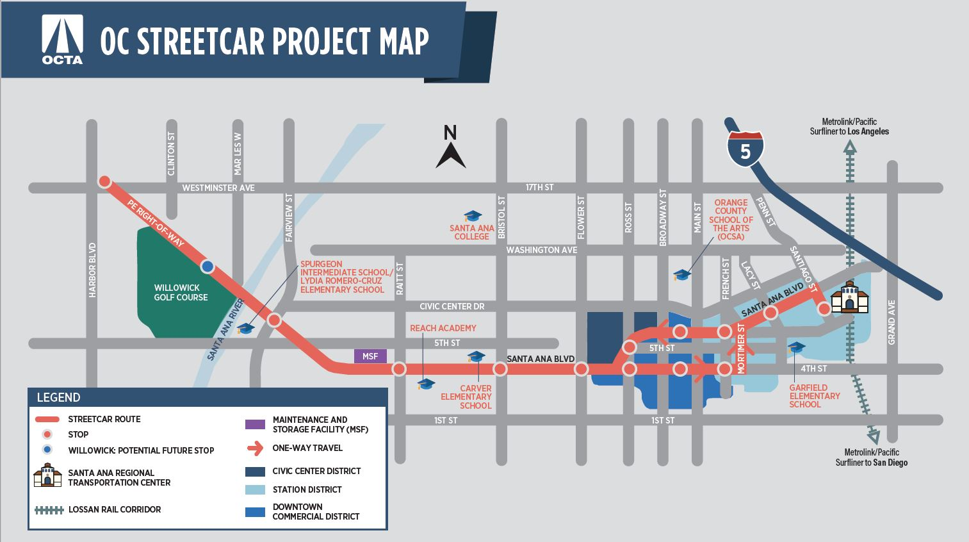
OC Streetcar Route & Stop Locations

Slide 4
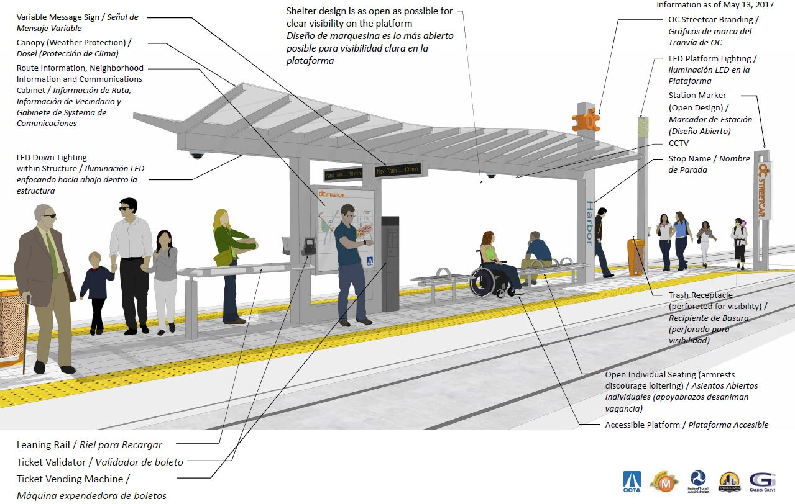

Conceptual Stop Design – Key Features

Slide 5
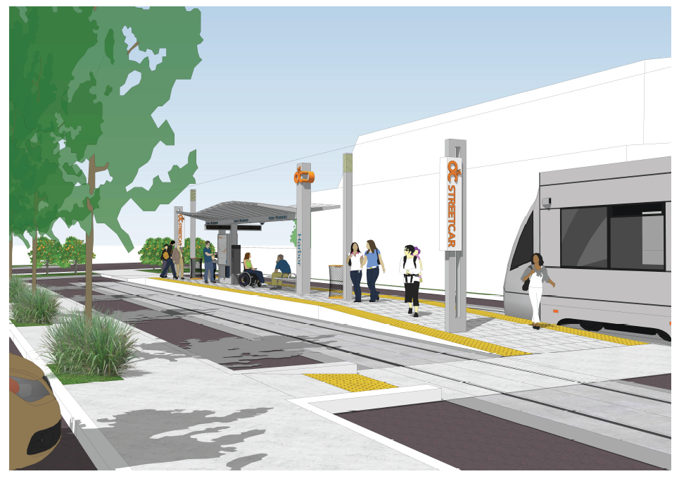
Center Running Stop – Harbor Blvd Terminus

Slide 6
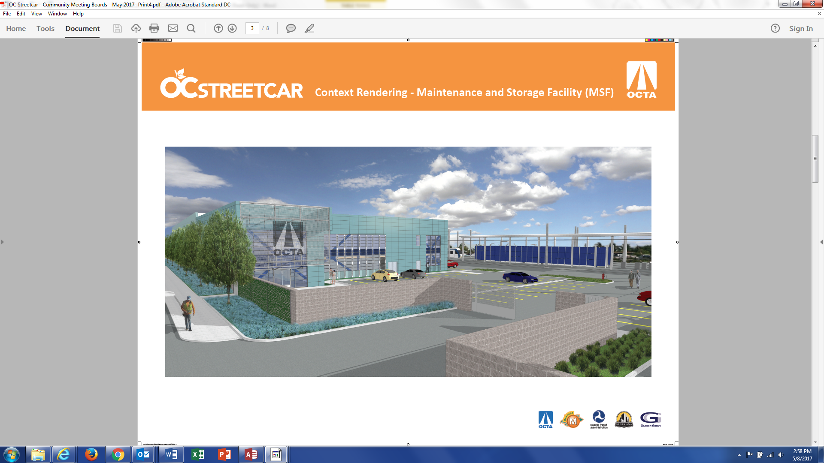
Maintenance and Storage Facility (MSF)

Slide 7
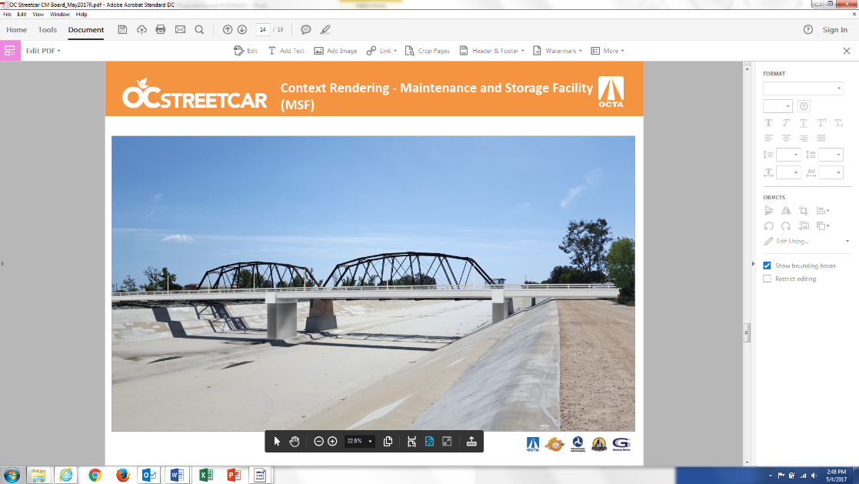
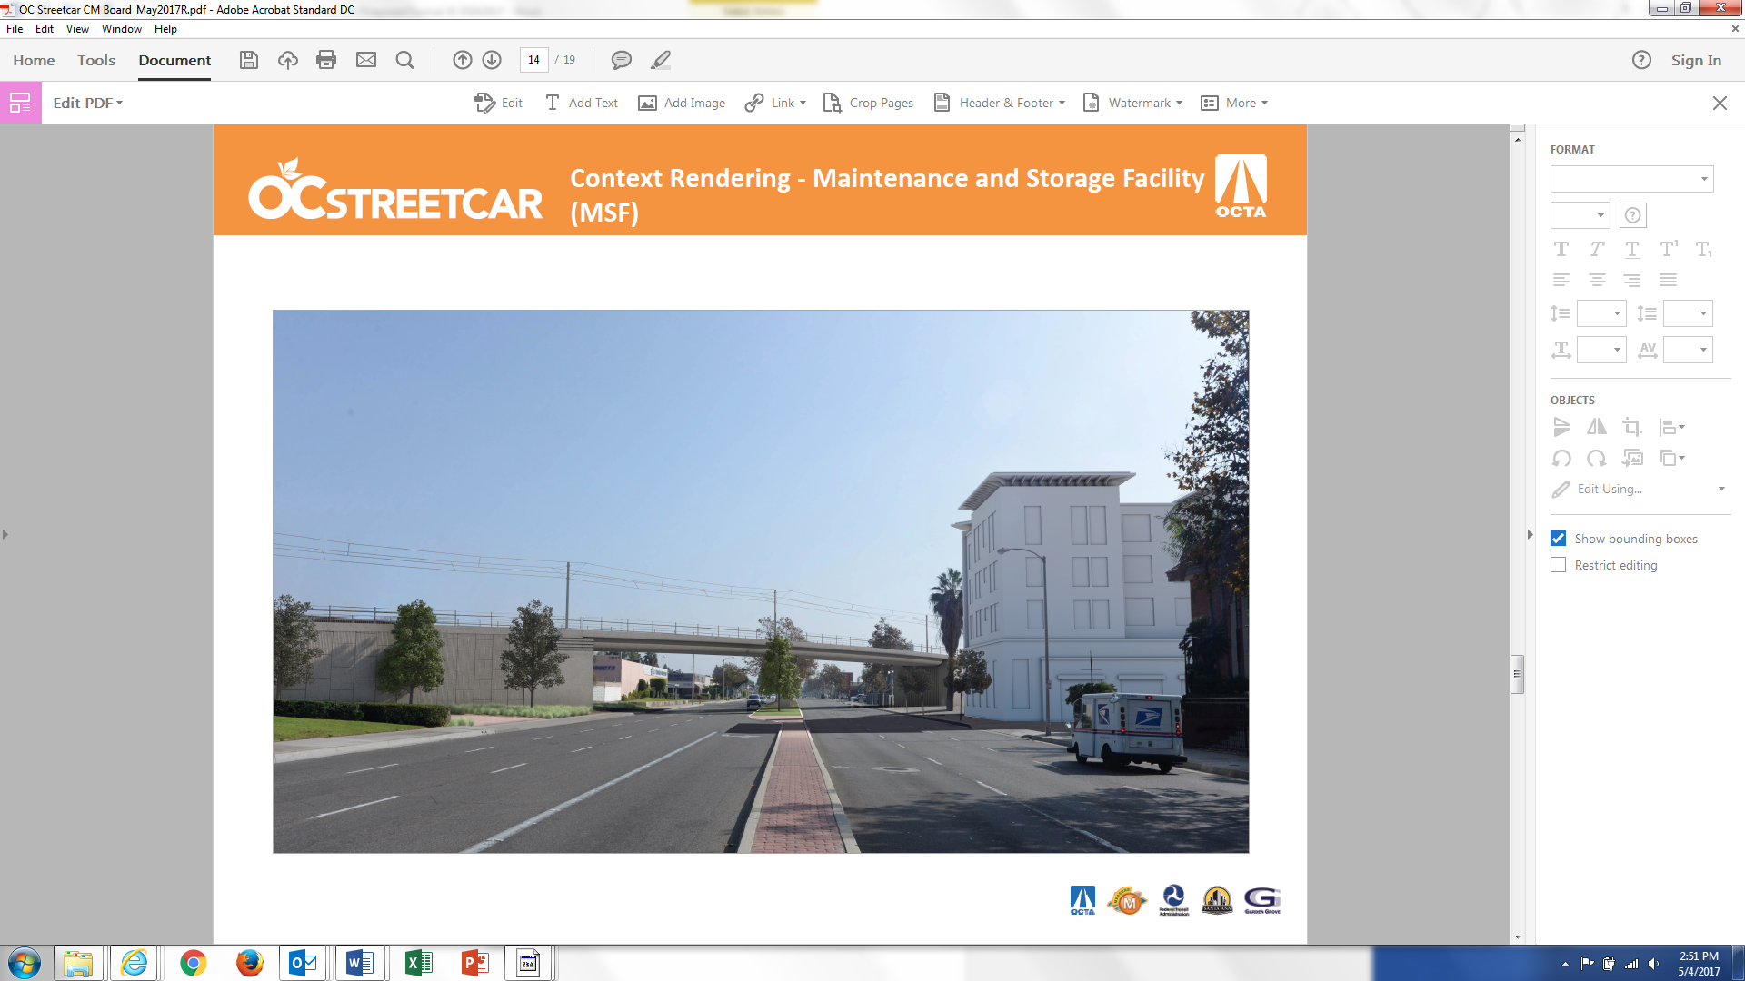
OC Streetcar Bridges
Westminster Bridge
View: Westminster Blvd. (Looking East)
Santa Ana River Bridge
View: Santa Ana River (Looking North)

Slide 8
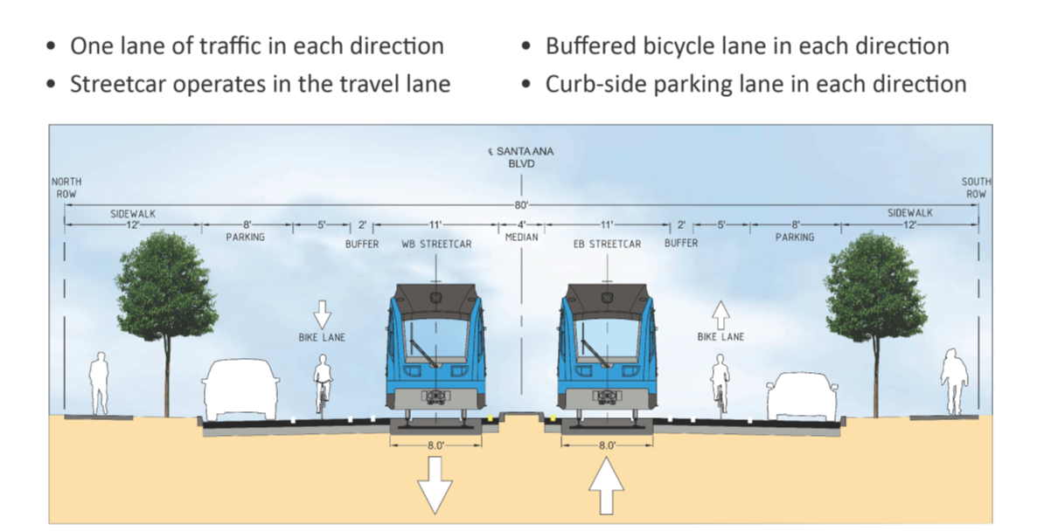
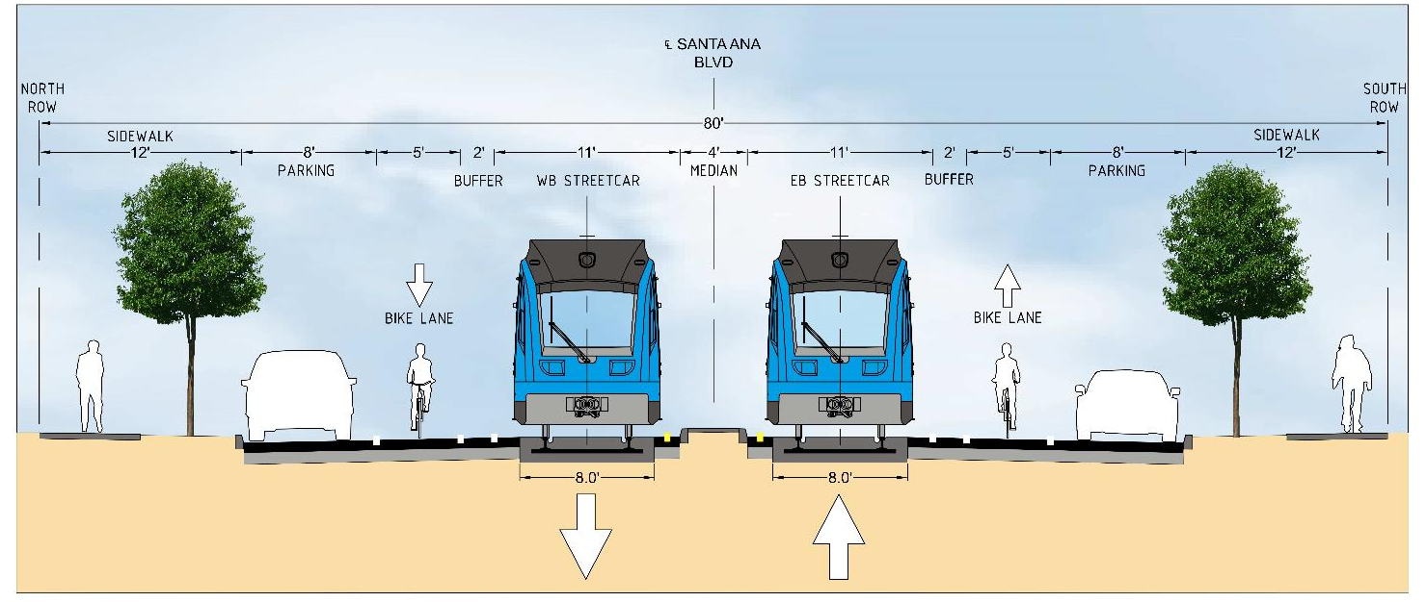
Street Cross Section
View: West Santa Ana Blvd. (Looking East)

Slide 9
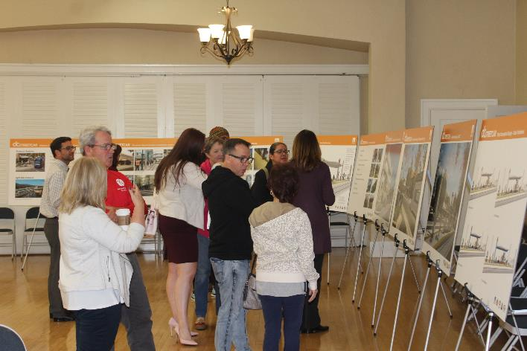
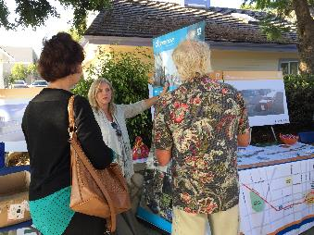
Community Outreach
Community Meetings/Open Houses
Stakeholder Working Group (SWG)
Elected Official & Stakeholder Briefings
Neighborhood and Business Association Meetings
Door-to-door Visits
Community Events & Pop-Up Booths
Sidewalk Decal Program
Business Support Program

Slide 10
OC Streetcar Funding
Updated Project Funding Plan approved by OCTA Board – May 22, 2017
All funding secured
Source | Amount ($ million)
Federal New Starts | $ 148.96
Federal CMAQ | 54.46
Federal FTA 5307 | 13.26
Subtotal Fed | $ 216.68
State Cap & Trade | 25.52
M2 - Project S | 165.56
Total | $ 407.76

Slide 11
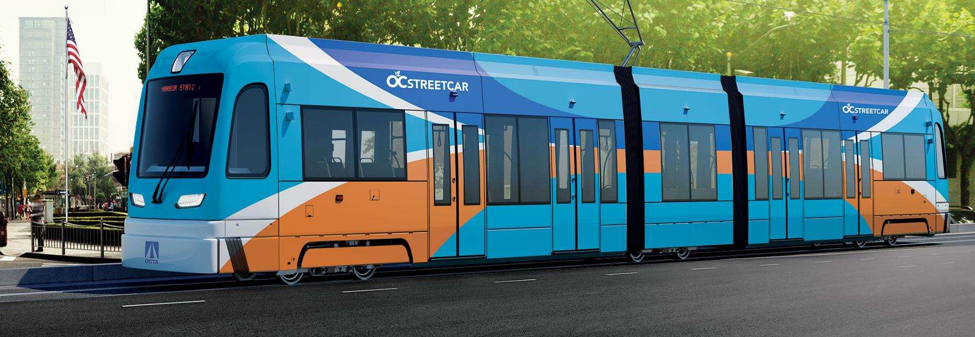
Vehicle Branding

Slide 12
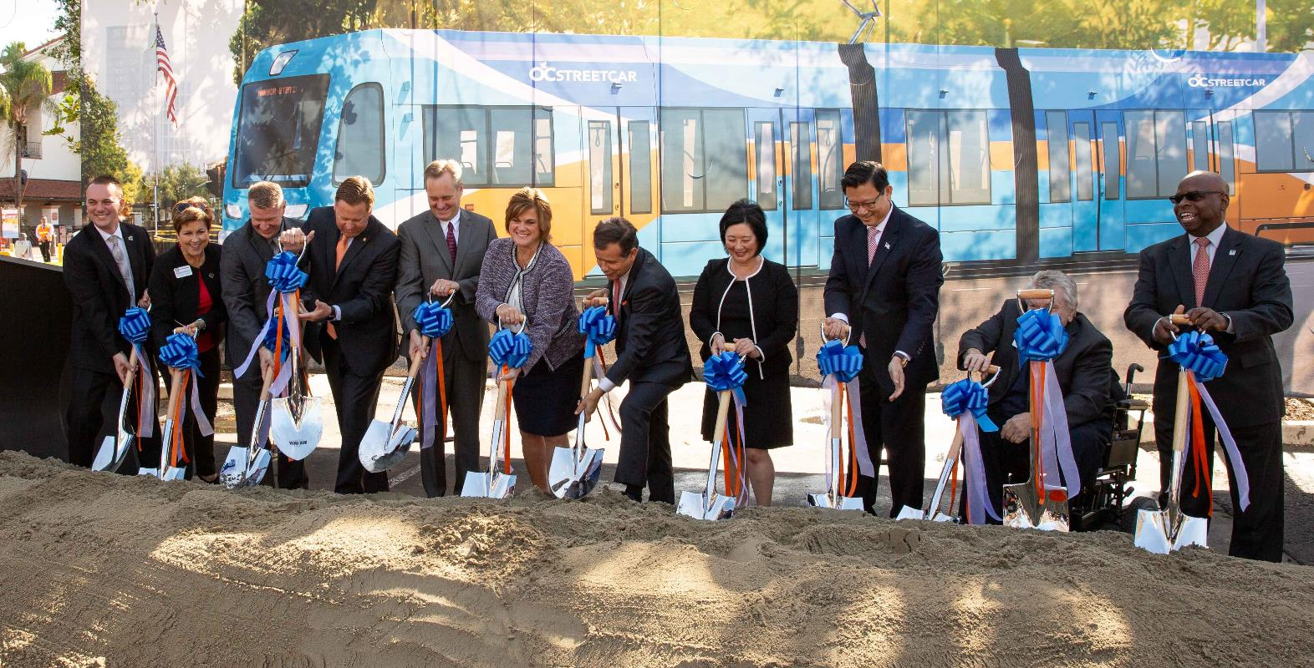
Full Funding Grant Agreement

Slide 13
OC Streetcar Project Status
Utility design and relocation progressing
Major procurements:
Construction
Vehicles
Operation & Maintenance
Vehicle branding
Construction Activity
Mobilization

Slide 14
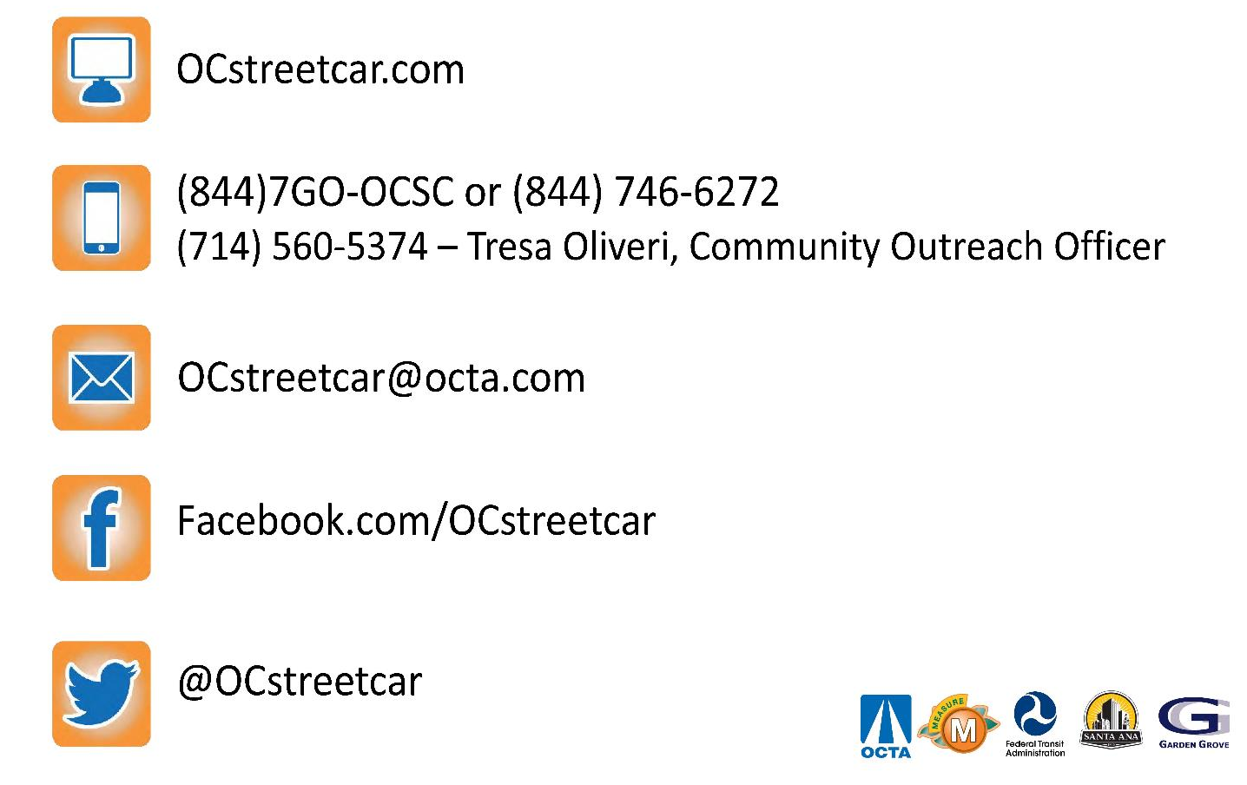
Stay Connected

